Slide 1




Name: Cristina Ortega Trujillo
Date: October 30, 2024
CriselPy (Crisel Nublo 🪻)
Cristina (Crisel Nublo) Ortega | LinkedIn

Slide 2

Outline

Slide 3

Executive Summary
Summary of methodologies
Data Collection through API
Data Collection with Web Scraping
Data Wrangling
Exploratory Data Analysis with SQL
Exploratory Data Analysis with Data Visualization
Interactive Visual Analytics with Folium
Machine Learning Prediction
Summary of all results
Exploratory Data Analysis result
Interactive analytics in screenshots
Predictive Analytics result

Slide 4

Introduction
Project Background and Context
SpaceX markets Falcon 9 rocket launches on its website at a price of $62 million per launch, significantly lower than the $165 million charged by other providers. A large part of this cost advantage comes from SpaceX's ability to reuse the first stage of the rocket. As such, being able to predict whether the first stage will successfully land is essential to understanding the overall cost-effectiveness of a launch. This information is particularly valuable for other companies that might compete with SpaceX by submitting bids for rocket launches. The primary objective of this project is to develop a machine learning pipeline capable of predicting whether the first stage of a Falcon 9 rocket will land successfully.
Problems to Address
Key Factors for Successful Landing: What are the critical variables that influence whether the rocket's first stage lands successfully?
Feature Interactions: How do different factors interact with one another to affect the likelihood of a successful landing?
Optimal Operating Conditions: What specific conditions need to be met to ensure that the rocket’s landing program achieves consistent success?
By addressing these questions, the project aims to enhance the understanding of factors driving successful landings and support better decision-making in rocket launch operations.

Slide 5

Section 1

Slide 6
Executive Summary
Data collection methodology:
Import Libraries and Define Auxiliary Functions
We imported necessary libraries such as requests, pandas, numpy, and datetime to handle data requests, manipulation, and analysis.
Pandas options were set to display all columns and data in a feature for better visibility.
Define Helper Functions
Several helper functions were defined to extract specific data from the SpaceX API:
getBoosterVersion(data): Extracts the booster version using the rocket column.
getLaunchSite(data): Extracts the launch site name, longitude, and latitude using the launchpad column.
getPayloadData(data): Extracts the payload mass and orbit using the payloads column.
getCoreData(data): Extracts various core-related data using the cores column.
Request and Parse SpaceX Launch Data
The SpaceX API URL for past launches was defined.
A GET request was made to the SpaceX API to retrieve the data.
The content of the response was checked to ensure it was successful.
A static JSON URL was used for consistent results.
The response content was decoded as JSON and converted into a pandas dataframe for further analysis.
Methodology

Slide 7
Methodology
Executive Summary
Data collection methodology:
Request and Parse the SpaceX Launch Data Using the GET Request
The request was verified to be successful with a 200-status response code.
The JSON response was converted into a pandas dataframe.
The first 5 rows of the dataframe were printed to inspect the data.
The dataframe was subset to keep only relevant columns and filter out rows with multiple cores or payloads.
The date_utc column was converted to a datetime datatype and the date was extracted.
The dates of the launches were restricted to a specific range.
Filter the Dataframe to Only Include Falcon 9 Launches
The dataframe was filtered using the BoosterVersion column to keep only Falcon 9 launches.
The FlightNumber column was reset to ensure sequential numbering.
Data Wrangling
Missing values in the dataset were identified and handled.
None values in the LandingPad column were retained to represent when landing pads were not used.

Slide 8
Executive Summary
Data collection methodology:
Dealing with Missing Values
The mean for the PayloadMass column was calculated.
np.nan values in the PayloadMass column were replaced with the calculated mean.
It was verified that the number of missing values in the PayloadMass column was zero.
Export Data
The cleaned and filtered dataframe was exported to a CSV file for the next section of the project.
Data Collection - Scraping:
HTML Request: Sent an HTTP GET request to the Wikipedia page.
HTML Parsing: Parsed the HTML content using BeautifulSoup.
Table Identification: Located the specific HTML table with launch records.
Column Extraction: Extracted column names from the table headers.
Row Iteration: Iterated through each row of the table to extract data.
Data Cleaning: Used helper functions to clean and format the extracted data.
Data Structuring: Organized the cleaned data into a dictionary.
DataFrame Creation: Converted the dictionary into a structured Pandas DataFrame.
Data Export: Exported the DataFrame to a CSV file for subsequent analysis
Methodology

Slide 9
Executive Summary
Data collection Wrangling
Import Libraries:
Imported necessary libraries: pandas for data manipulation and numpy for numerical operations.
Load Dataset:
Loaded SpaceX dataset from a CSV file.
Data Cleaning:
Identified and calculated the percentage of missing values in each attribute.
Determined which columns are numerical and categorical.
Exploratory Data Analysis:
Calculated the number of launches at each site using the value_counts() method on the LaunchSite column.
Calculated the number and occurrence of each orbit using the value_counts() method on the Orbit column.
Calculated the number and occurrence of mission outcomes using the value_counts() method on the Outcome column.
Create Landing Outcome Labels:
Created a set of outcomes where the second stage did not land successfully.
Generated a list where each element is zero if the corresponding row in Outcome is in the set of bad outcomes; otherwise, it's one.
Assigned this list to the variable landing_class.
Add Classification Variable:
Added the landing_class variable to the dataset to represent the outcome of each launch (0 for unsuccessful, 1 for successful).
Determine Success Rate:
Calculated the success rate of the first stage landing.
Export Processed Data:
Exported the processed dataset to a CSV file for further analysis.
Methodology

Slide 10
Methodology
Executive Summary
Perform exploratory data analysis (EDA) using visualization and SQL
Perform interactive visual analytics using Folium and Plotly Dash
Perform predictive analysis using classification models
How to build, tune, evaluate classification models

Slide 11

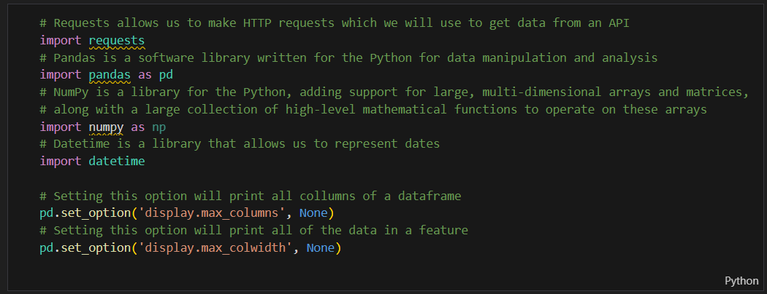
https://github.com/CriselPy/Spacex-launch-data/blob/main/Collecting%20the%20Data/jupyter-labs-spacex-data-collection-api-v2.ipynb
Data Collection
Import necessary libraries: Requests, Pandas, Numpy, Datetime.
Set pandas options to display all columns and data in a feature.
Import Libraries and Define Auxiliary Functions

Slide 12

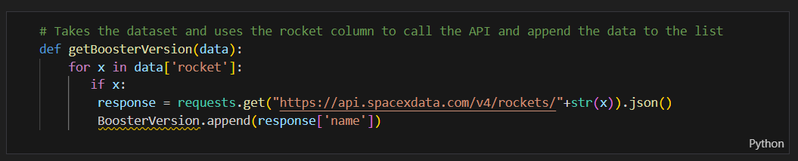
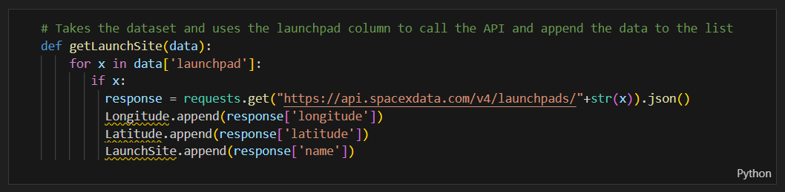


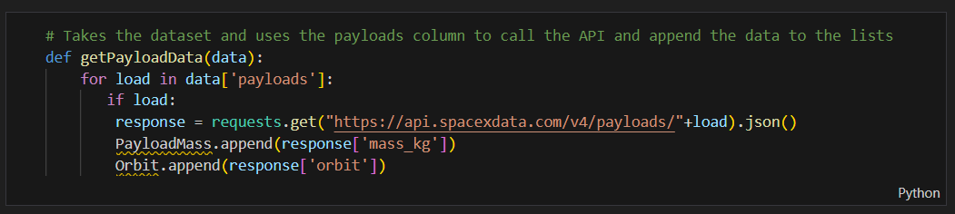
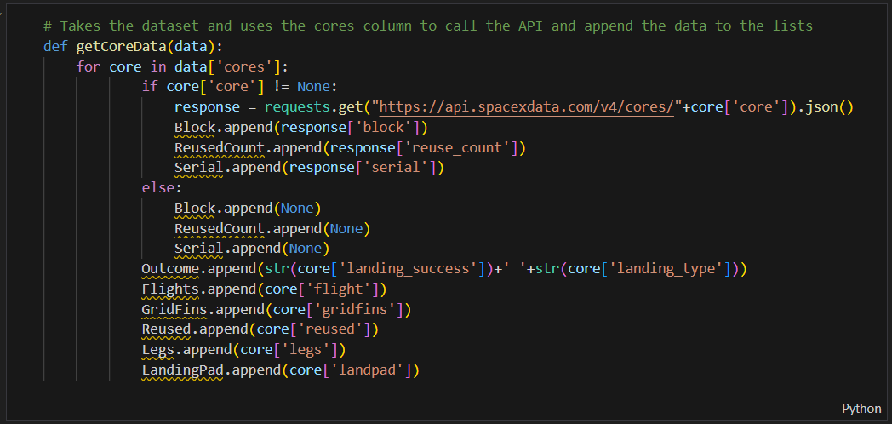

Data Collection
getBoosterVersion(data): Uses the rocket column to call the API and append the booster version to a list.
getLaunchSite(data): Uses the launchpad column to call the API and append the launch site name, longitude, and latitude to lists.
Define Helper Functions
getPayloadData(data): Uses the payloads column to call the API and append the payload mass and orbit to lists.
getCoreData(data): Uses the cores column to call the API and append various core-related data to lists.

Slide 13
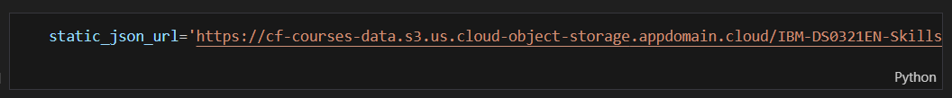

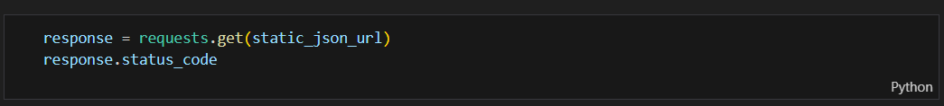

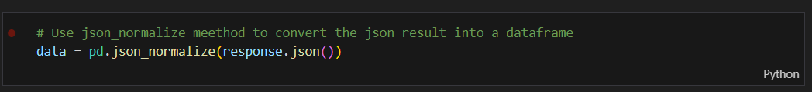

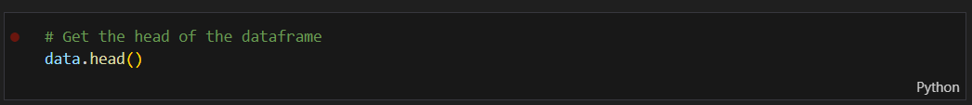

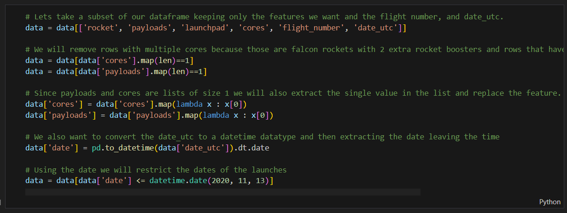
Define the SpaceX API URL for past launches.
Make a GET request to the SpaceX API.
Check the content of the response.
Use a static JSON URL for consistent results.
Verify the request was successful with a 200-status response code.
Request and Parse SpaceX Launch Data
Convert the JSON response into a pandas dataframe.
Print the first 5 rows of the dataframe.
Convert date_utc to a datetime datatype and extract the date.

Slide 14
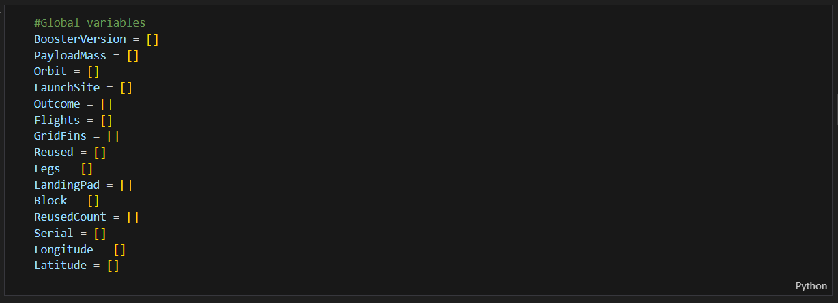

Data Collection
Request and Parse SpaceX Launch Data
Subset the dataframe to keep only relevant columns and filter out rows with multiple cores or payloads.

Slide 15
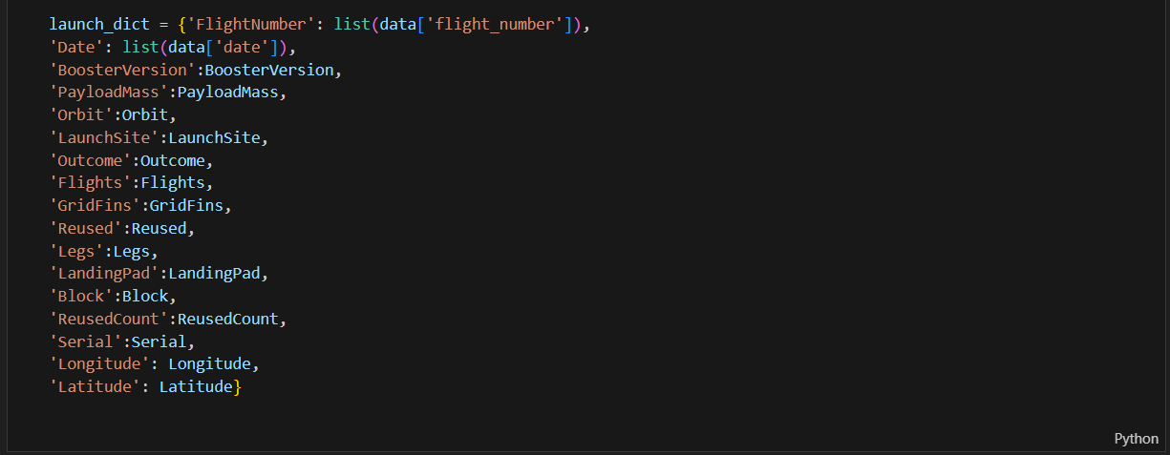

Data Collection
Request and Parse SpaceX Launch Data
Restrict the dates of the launches and create a Dataframe.

Slide 16
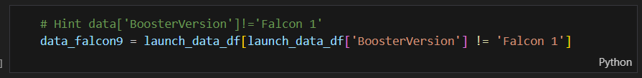
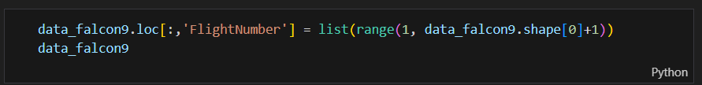
Filter the dataframe using the BoosterVersion column to keep only Falcon 9 launches.
Data Collection
Filter the dataframe to only include Falcon 9 launches
Reset the FlightNumber column.

Slide 17
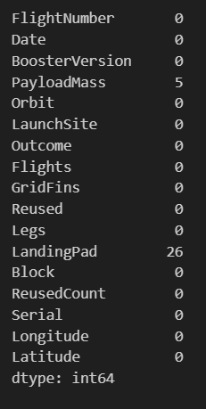
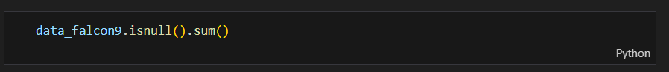
Data Collection
Identify and handle missing values in the dataset.
Retain None values in the LandingPad column to represent when landing pads were not used.
Data Wrangling

Slide 18
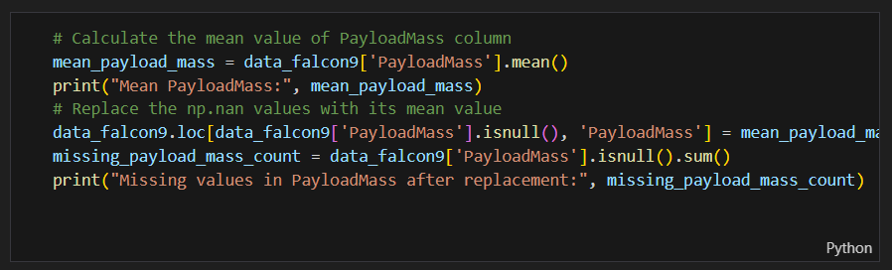
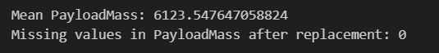
Calculate the mean for the PayloadMass column.
Replace np.nan values in the PayloadMass column with the calculated mean.
Verify that the number of missing values in the PayloadMass column is zero.
Data Collection
Dealing with Missing Values

Slide 19
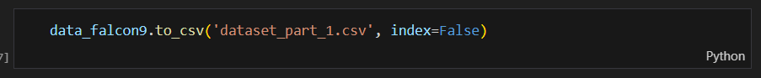
Spacex-launch-data/Collecting the Data/dataset_part_1.csv at main · CriselPy/Spacex-launch-data
Data Collection
Export the cleaned and filtered dataframe to a CSV file for the next section.
Export Data

Slide 20
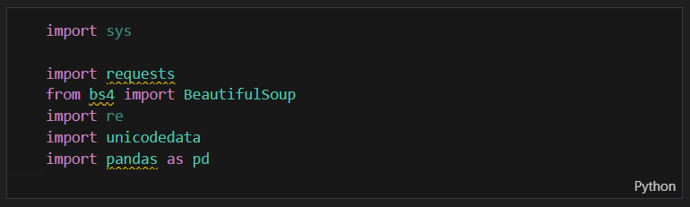
Spacex-launch-data/Collecting the Data/jupyter-labs-webscraping.ipynb at main · CriselPy/Spacex-launch-data
Data Collection - Scraping
Import the necessary packages for web scraping and data manipulation.
Imported Packages:
sys: System-specific parameters and functions.
requests: Perform HTTP requests.
BeautifulSoup: Parse HTML and XML documents.
re: Regular expressions.
unicodedata: Unicode data manipulation.
pandas: Data manipulation and analysis.
Importing Packages

Slide 21
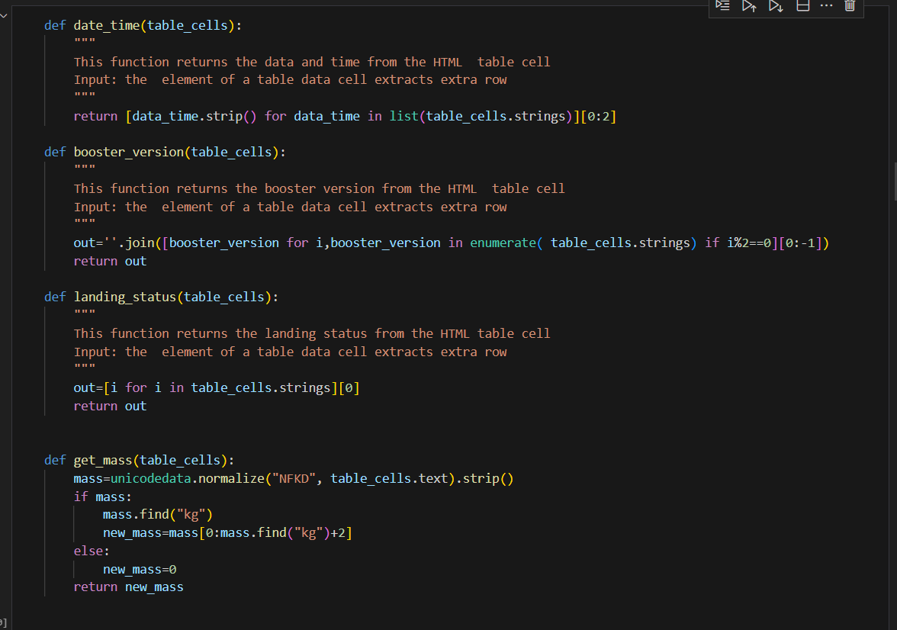
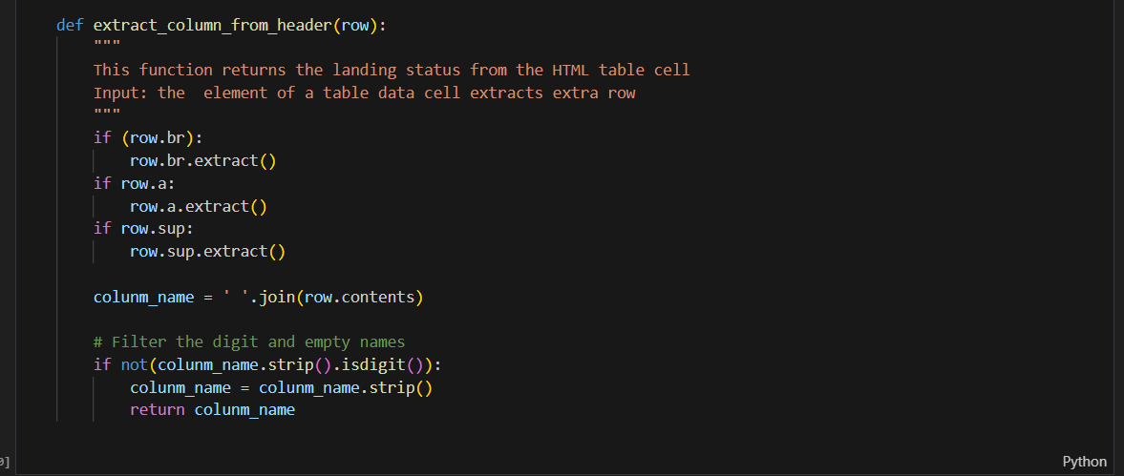
Data Collection - Scraping
Define helper functions to process HTML table cells.
Functions
date_time(table_cells): Extracts date and time from a table cell.
booster_version(table_cells): Extracts the booster version from a table cell.
landing_status(table_cells): Extracts the landing status from a table cell.
get_mass(table_cells): Extracts the payload mass from a table cell.
extract_column_from_header (row): Extracts the column name from a table header cell.
Helper Functions

Slide 22
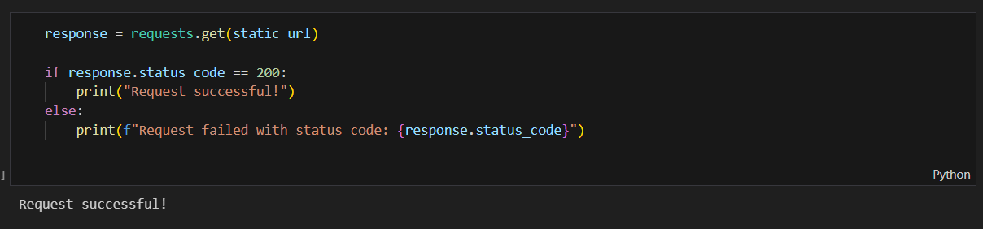
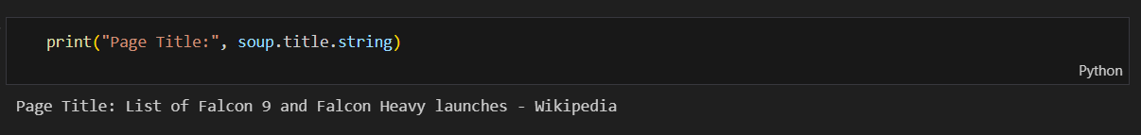
Data Collection - Scraping
Perform an HTTP GET request to obtain the Wikipedia HTML page with launch records.
Request the HTML page using requests.get().
Requesting the HTML Page
Create a BeautifulSoup object from the HTML response.
Verify the page title to ensure it has loaded correctly.

Slide 23
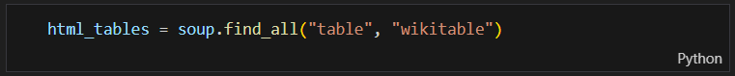
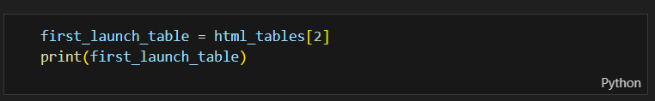
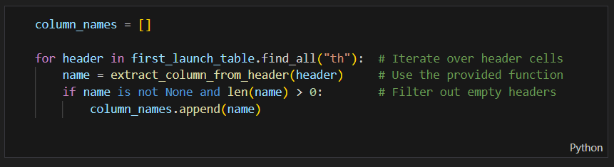
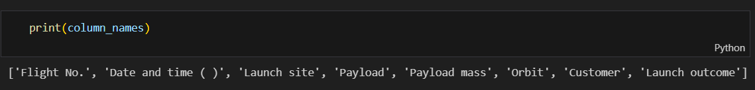
Data Collection - Scraping
Extract the column names from the HTML table containing launch records
Find all tables on the HTML page
Identify the table containing the launch records.
Extracting Column Names
Iterate through the <th> elements to extract column names using the extract_column_from_header() function and print.

Slide 24
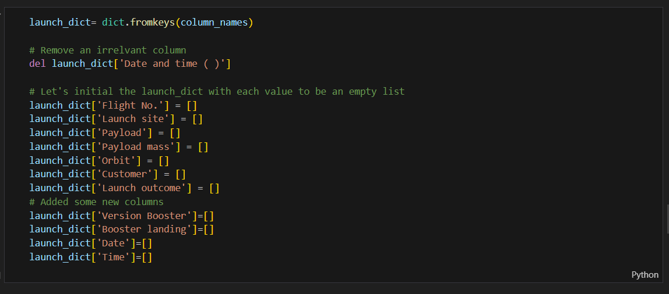
Data Collection - Scraping
Create an empty dictionary with keys from the extracted column names.
Initialize the dictionary with empty lists for each column
Creating a Dictionary for Launch Data
Remove irrelevant columns if necessary

Slide 25
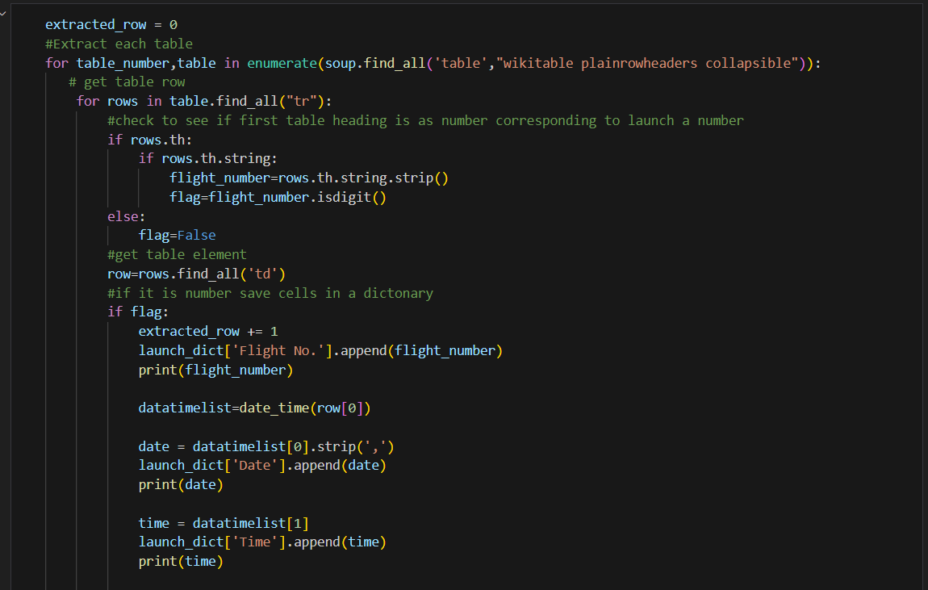
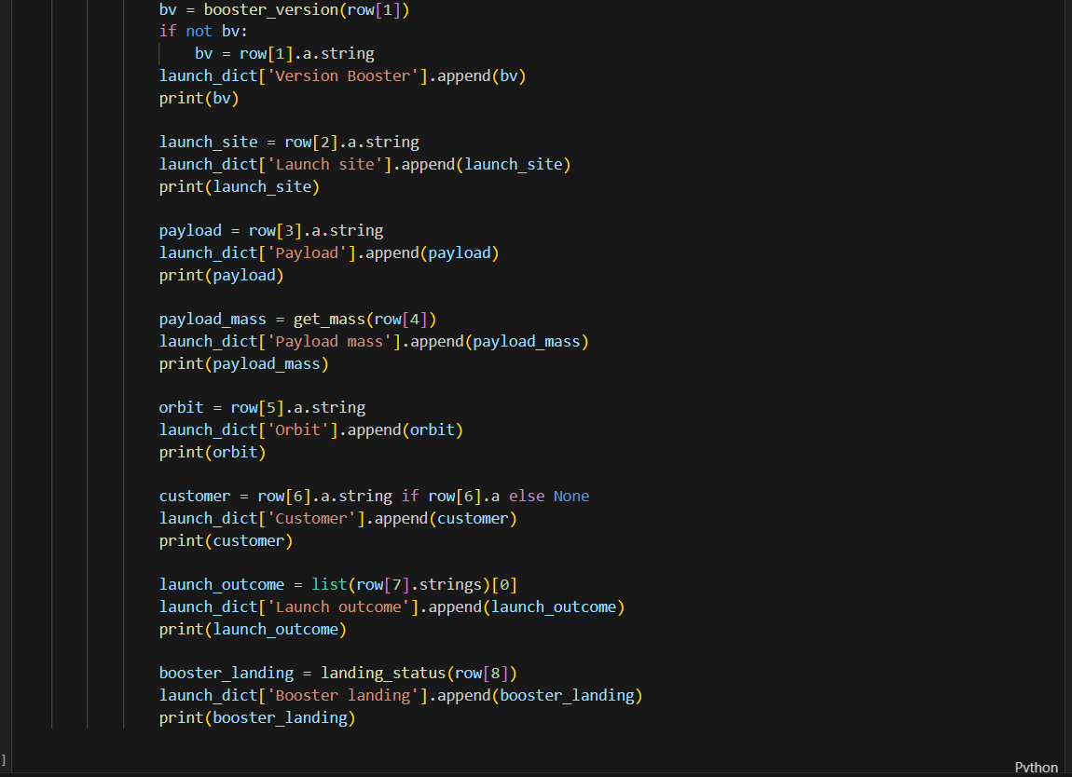
Data Collection - Scraping
Iterate through the rows of the HTML table to extract launch data and fill the dictionary.
Iterate through the table rows
Filling the Dictionary with Launch Records
Check if the row contains a flight number
Extract data from each cell in the row and add it to the dictionary.

Slide 26
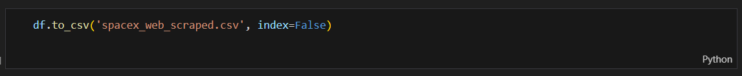
Spacex-launch-data/Collecting the Data/spacex_web_scraped.csv at main · CriselPy/Spacex-launch-data
Data Collection - Scraping
Create a Pandas DataFrame from the launch data dictionary.
Convert the dictionary into a Pandas DataFrame
Creating a DataFrame
Export the DataFrame to a CSV file for further use

Slide 27
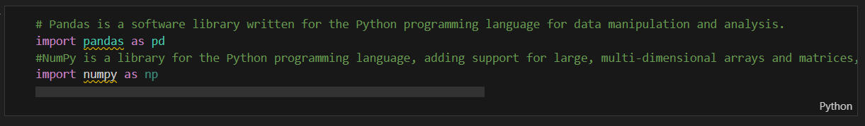
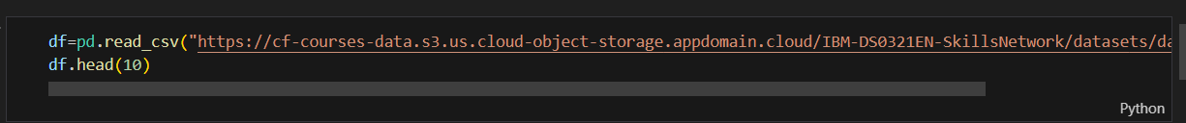
Spacex-launch-data/Data Wrangling/labs-jupyter-spacex-Data wrangling-v2.ipynb at main · CriselPy/Spacex-launch-data
Data Wrangling
Import Libraries and Define Auxiliary Functions
Data Analysis
Load Space X dataset, from last section
Identify and calculate the percentage of the missing values in each attribute
Identify which columns are numerical and categorical

Slide 28
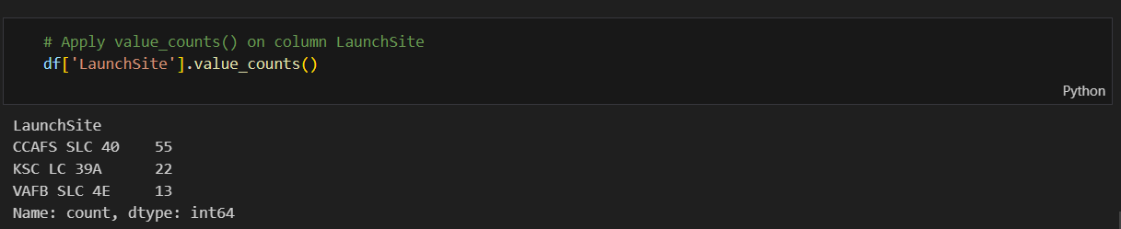
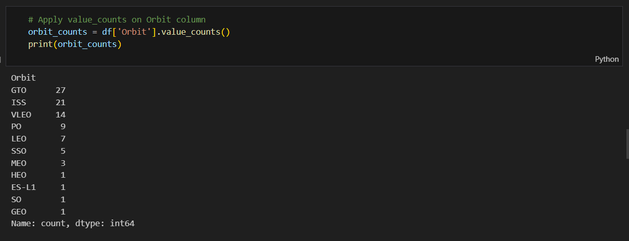
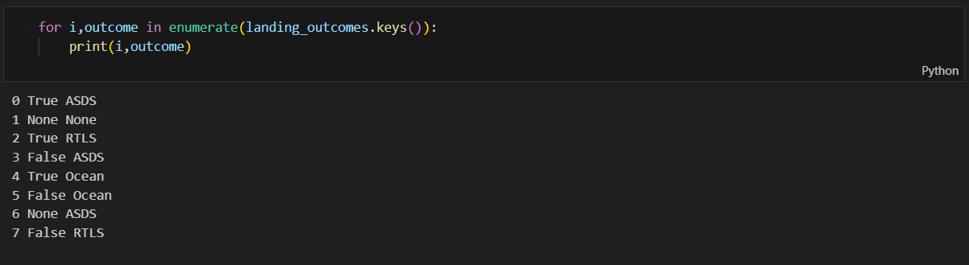
Data Wrangling
Use the method `value_counts()` on the column `LaunchSite` to determine the number of launches on each site:
Use the method `.value_counts()` to determine the number and occurrence of each orbit in the column `Orbit`
Calculate the number and occurrence of mission outcome of the orbits
Use the method `.value_counts()` on the column `Outcome` to determine the number of `landing_outcomes`. Then assign it to a variable landing_outcomes.

Slide 29
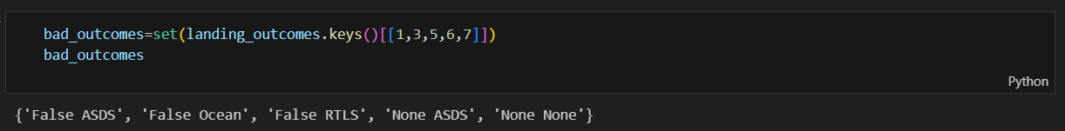
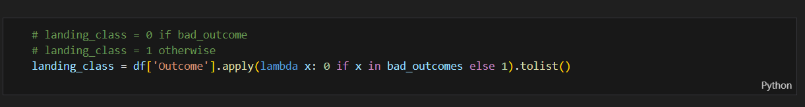
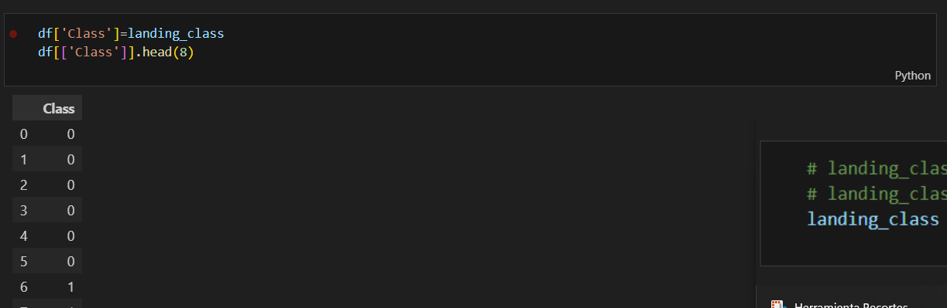
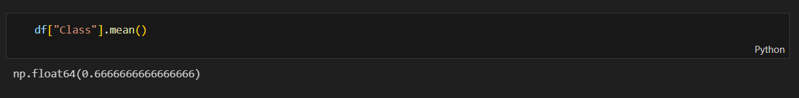
Data Wrangling
We create a set of outcomes where the second stage did not land successfully:
We create a set of outcomes where the second stage did not land successfully:
Create a landing outcome label from Outcome column
This variable will represent the classification variable that represents the outcome of each launch. If the value is zero, the first stage did not land successfully; one means the first stage landed successfully.
We can use the following line of code to determine the success rate:

Slide 30
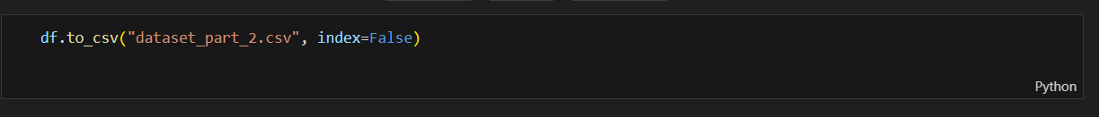
Spacex-launch-data/Data Wrangling/dataset_part_2.csv at main · CriselPy/Spacex-launch-data
Data Wrangling
We can now export it to a CSV for the next section, but to make the answers consistent, in the next lab we will provide data in a pre-selected date range

Slide 31
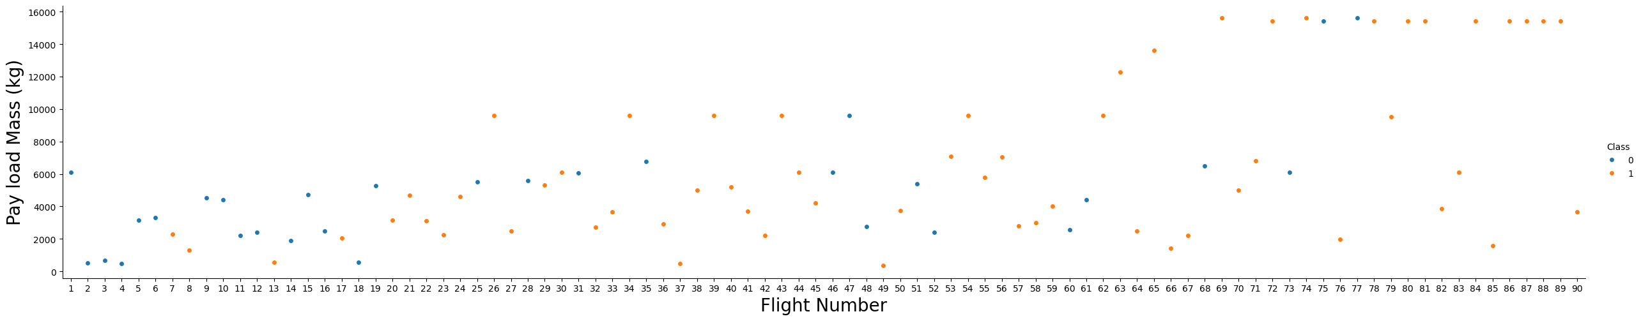
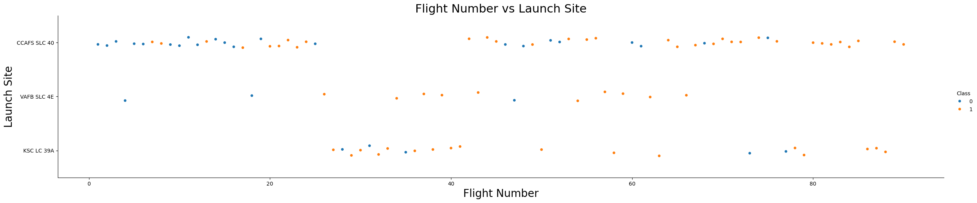
https://github.com/CriselPy/Spacex-launch-data/blob/main/Exploratory%20Analysis%20Using%20Pandas%20and%20Matplotlib/jupyter-labs-eda-dataviz-v2.ipynb
EDA with Data Visualization
Flight Number vs. Payload Mass:
Chart Type: Scatter plot with hue.
Purpose: To observe the relationship between flight number, payload mass, and launch success. It helps to see if higher flight numbers and payload masses affect the likelihood of a successful landing.
Flight Number vs. Launch Site:
Chart Type: Scatter plot with hue.
Purpose: To visualize the relationship between flight number and launch site, and how it correlates with the success of the launch.

Slide 32
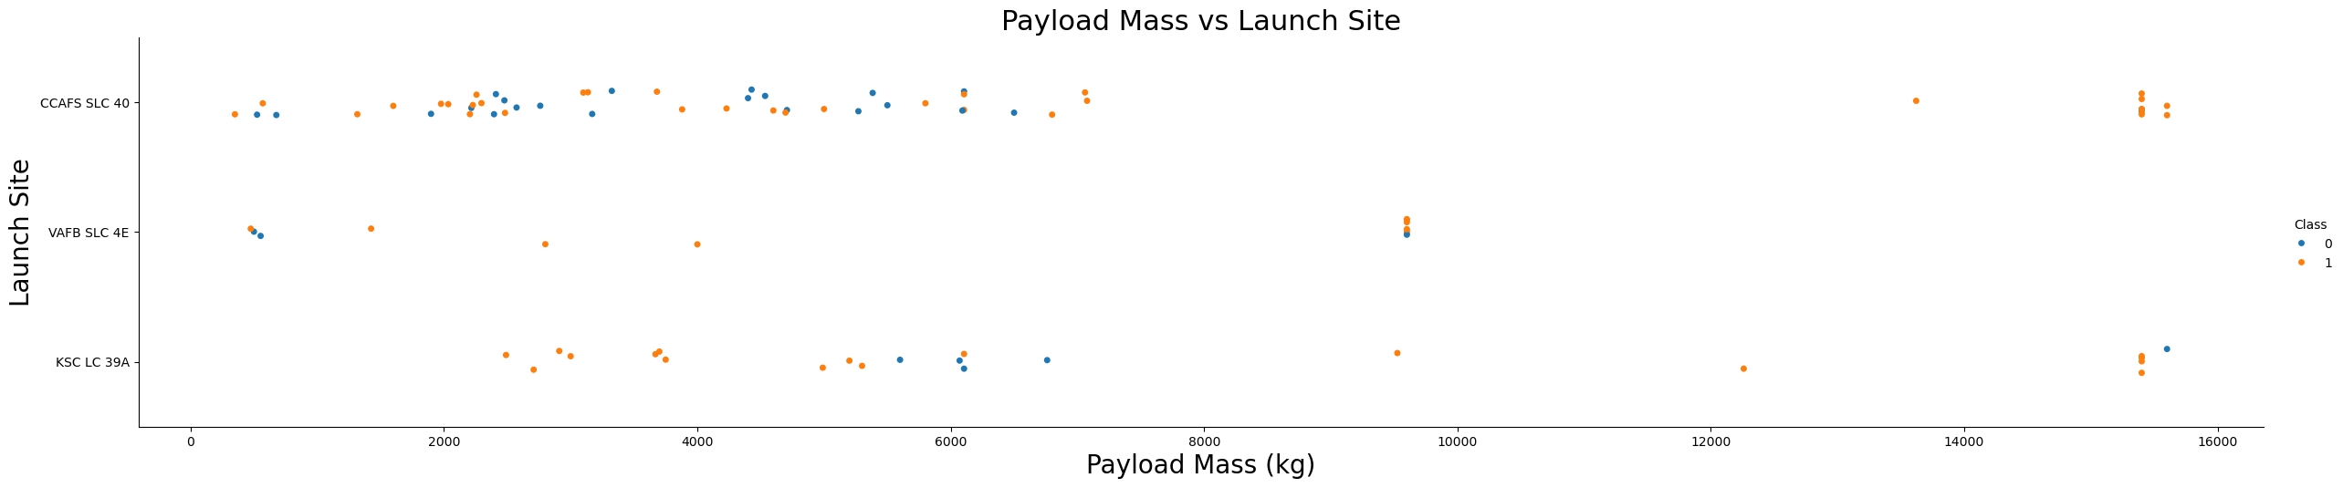
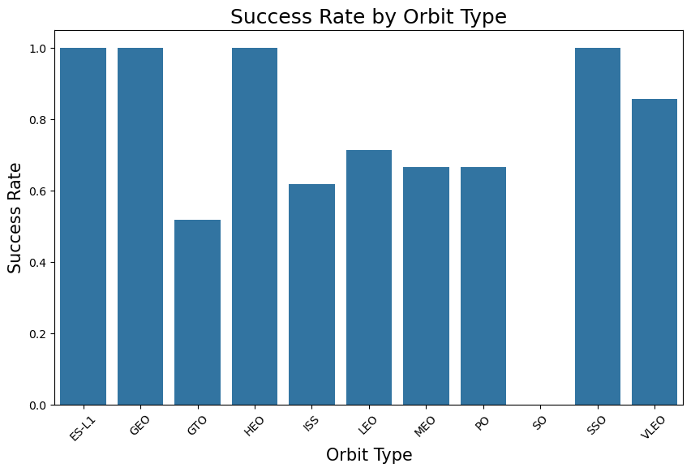
EDA with Data Visualization
Payload Mass vs. Launch Site:
Chart Type: Scatter plot with hue.
Purpose: To examine the relationship between payload mass and launch site, and how it affects the success of the launch.
Success Rate by Orbit Type:
Chart Type: Bar chart.
Purpose: To visualize the success rate for each orbit type, helping to identify which orbits have higher success rates.

Slide 33
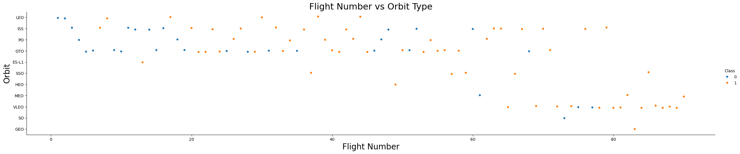
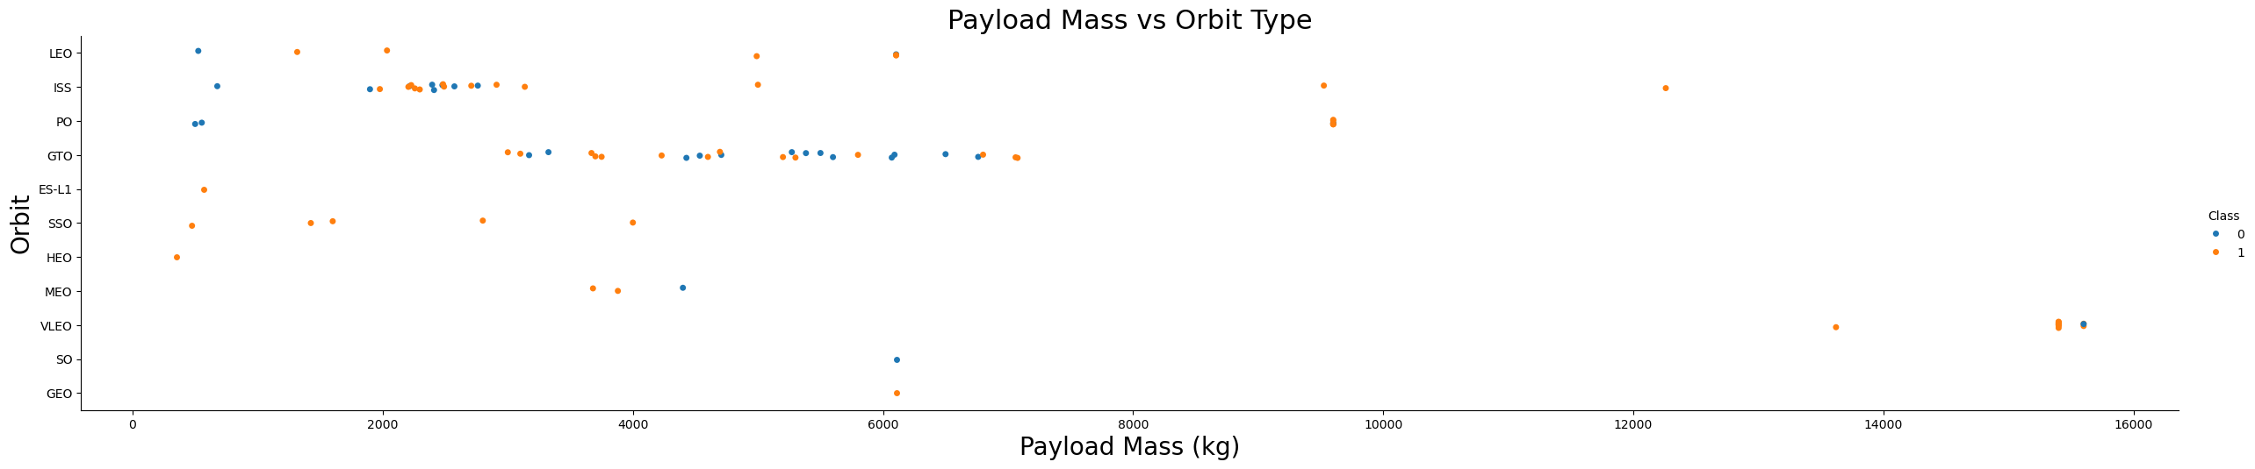
EDA with Data Visualization
Flight Number vs. Orbit Type:
Chart Type: Scatter plot with hue.
Purpose: To explore the relationship between flight number and orbit type, and how it correlates with the success of the launch.
Payload Mass vs. Orbit Type:
Chart Type: Scatter plot with hue.
Purpose: To investigate the relationship between payload mass and orbit type, and how it affects the success of the launch.

Slide 34
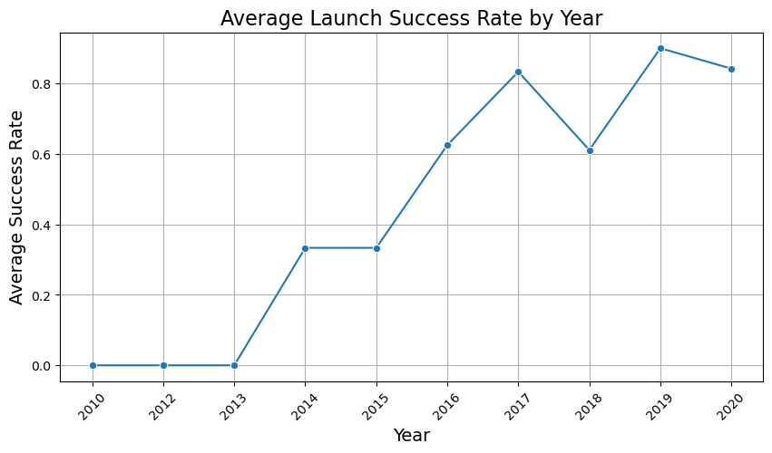
Spacex-launch-data/Exploratory Analysis Using Pandas and Matplotlib/dataset_part_3.csv at main · CriselPy/Spacex-launch-data
EDA with Data Visualization
Average Launch Success Rate by Year:
Chart Type: Line chart.
Purpose: To observe the trend of average launch success rates over the years, identifying any patterns or improvements over time.

Slide 35
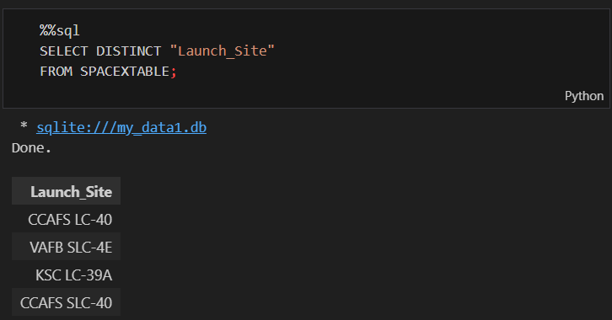



EDA with SQL
https://github.com/CriselPy/Spacex-launch-data/blob/main/Exploratory%20Analysis%20Using%20SQL/jupyter-labs-eda-sql-coursera_sqllite.ipynb
Display the names of the unique launch sites in the space mission.
Display 5 records where launch sites begin with the string 'CCA'.
Display the total payload mass carried by boosters launched by NASA (CRS).
Display average payload mass carried by booster version F9 v1.1.

Slide 36



EDA with SQL
List the date when the first successful landing outcome in ground pad was achieved.
List the names of the boosters which have success in drone ship and have payload mass greater than 4000 but less than 6000
List the total number of successful and failure mission outcomes.

Slide 37



EDA with SQL
List the names of the booster_versions which have carried the maximum payload mass.
List the records which display the month names, failure landing outcomes in drone ship, booster versions, and launch site for the months in the year 2015.
Rank the count of landing outcomes between the date 2010-06-04 and 2017-03-20, in descending order.

Slide 38


Build an Interactive Map with Folium
https://github.com/CriselPy/Spacex-launch-data/blob/main/Interactive%20Visual%20Analytics%20and%20Dashboard/lab-jupyter-launch-site-location-v2.ipynb
Markers and Circles for Launch Sites:
Markers: Added markers for each launch site with a text label showing the site name.
Circles: Added circles with a radius of 100 meters around each launch site to highlight their locations.
Reason: To visually identify and label the locations of SpaceX launch sites on the map.

Slide 39



Build an Interactive Map with Folium
MarkerCluster for Launch Outcomes:
Markers: Added markers for each launch record, colored green for successful launches and red for failed launches.
Reason: To visualize the success and failure rates of launches at each site, making it easier to identify patterns.

Slide 40


Build an Interactive Map with Folium
MousePosition Plugin:
MousePosition: Added a plugin to display the coordinates of the mouse pointer on the map.
Reason: To easily find and mark the coordinates of points of interest (e.g., coastline, railway, highway).

Slide 41



Build an Interactive Map with Folium
Spacex-launch-data/Interactive Visual Analytics and Dashboard/spacex_launch_geo.csv at main · CriselPy/Spacex-launch-data
Distance Markers and Lines:
Markers: Added markers at points of interest (e.g., closest coastline, railway, highway, city) with labels showing the distance from the launch site.
PolyLines: Added lines connecting the launch site to these points of interest.
Reason: To analyze the proximity of launch sites to key infrastructure and geographical features, providing insights into site selection criteria.

Slide 42



Build a Dashboard with Plotly Dash
https://github.com/CriselPy/Spacex-launch-data/blob/main/SpaceX%20Dash%20App/spacex_dash_app.py
Payload Mass Distribution Plot:
This plot likely visualizes the distribution of payload masses for SpaceX launches.
It helps users understand the range and frequency of different payload masses.
Plots/Graphs
Launch Success Rate by Site:
This plot likely shows the success rate of launches for different launch sites.
It provides insights into the performance of various launch sites.
Correlation between Payload and Success:
This plot likely examines the relationship between payload mass and launch success.
It helps users analyze if heavier or lighter payloads have higher success rates.

Slide 43

Build a Dashboard with Plotly Dash
Dropdown for Launch Site Selection:
Allows users to filter the data and plots based on the selected launch site.
Provides a focused view of the performance and statistics for a specific site.
Interactions
Slider for Payload Mass Range:
- Enables users to adjust the range of payload masses to be displayed in the plots.
- Helps in analyzing trends and patterns within a specific payload mass range.

Slide 44
Build a Dashboard with Plotly Dash
Reasons for Adding These Plots and Interactions:
Payload Mass Distribution Plot: To give users an overview of the payload capacities handled by SpaceX.
Launch Success Rate by Site: To compare the performance of different launch sites and identify any site-specific issues or strengths.
Correlation between Payload and Success: To investigate if there is any significant impact of payload mass on the success of launches.
Dropdown for Launch Site Selection: To provide a customizable and interactive experience, allowing users to drill down into specific sites.
Slider for Payload Mass Range: To enable detailed analysis within user-defined payload mass ranges, making the dashboard more flexible and informative.

Slide 45

Predictive Analysis (Classification)
https://github.com/CriselPy/Spacex-launch-data/blob/main/Predictive%20Analysis%20(Classification)/SpaceX-Machine-Learning-Prediction-Part-5-v1.ipynb
Confusion Matrix
Description: Shows the model's performance in terms of true positives, false positives, true negatives, and false negatives.
Key Points:
True Positives (TP): Correct predictions of successful landing.
False Positives (FP): Incorrect predictions of successful landing.
True Negatives (TN): Correct predictions of no landing.
False Negatives (FN): Incorrect predictions of no landing.

Slide 46

Predictive Analysis (Classification)
2. ROC Curve (Receiver Operating Characteristic)
Description: Shows the model's ability to distinguish between classes.
Key Points:
X-axis (False Positive Rate): Rate of false positives.
Y-axis (True Positive Rate): Rate of true positives.
AUC (Area Under Curve): Area under the curve; the closer to 1, the better.

Slide 47
Predictive Analysis (Classification)
3. Precision vs Parameters
Description: Shows how the model's precision varies with different parameter values.
Key Points:
X-Axis: Parameter values (e.g., C in SVM).
Y-Axis: Model precisión.
Curve: Indicates the model's performance with different parameter configurations.

Slide 48

Predictive Analysis (Classification)
We imported the dataset using numpy and pandas, processed it, and divided it into training and testing sets.
We developed various machine learning models and adjusted their hyperparameters with GridSearchCV.
We evaluated the models using accuracy as the performance metric and enhanced the results through feature engineering and tuning algorithms.
Ultimately, we identified the classification model with the best performance.

Slide 49
Results
Exploratory Data Analysis Results
Analyzed the relationship between flight number, payload mass, and launch success.
Visualized launch success rates across different launch sites and orbit types.
Observed trends in launch success rates over the years.
Interactive Analytics Demo in Screenshots
Demonstrated interactive visualizations using seaborn and matplotlib.
Included scatter plots, bar charts, and line charts to explore data relationships.
Predictive Analysis Results
Engineered features for predictive modeling.
Created dummy variables for categorical data.
Prepared data for future predictive analysis tasks.

Slide 50

Section 2

Slide 51
The scatter plot of Flight Number vs. Launch Site is used to visualize the relationship between the sequential flight numbers and the different launch sites.
X-axis (Flight Number): This axis represents the flight number, which is a sequential identifier for each flight. It helps in understanding the order and frequency of the flights.
Y-axis (Launch Site): This axis represents the launch sites. Each unique launch site is plotted as a distinct category on the y-axis.
Hue (Class): The hue parameter is used to differentiate the success (Class=1) and failure (Class=0) of the launches. Different colors are used to represent successful and unsuccessful launches.
Interpretation
Clusters: Points that are vertically aligned indicate multiple flights from the same launch site. This helps in identifying which launch sites are used more frequently.
Trends: If there is a pattern in the distribution of points, it might indicate a preference or trend in using certain launch sites over time.
Success Rate: By observing the colors (hue) of the points, you can infer the success rate of launches from different sites. For example, if a particular launch site has more points of the color representing success, it indicates a higher success rate for that site.
Flight Number vs. Launch Site

Slide 52
The scatter plot above shows the relationship between the payload mass and the launch site. Each point represents a launch, with the x-axis showing the payload mass in kilograms and the y-axis showing the launch site.
The hue indicates the class of the launch, where different colors represent different classes (e.g., successful or unsuccessful landings).
This visualization helps to identify any patterns or trends in the data, such as whether certain launch sites are associated with higher payloads or different success rates.
Payload vs. Launch Site

Slide 53
The bar chart above shows the success rate of launches for each orbit type.
The x-axis represents the different orbit types, while the y-axis shows the success rate, which is the proportion of successful launches for each orbit type.
This chart helps to identify which orbit types have higher success rates and can provide valuable insights for future missions.
Success rate by Orbit type

Slide 54
The scatter plot above shows the relationship between the flight number and the orbit type. Each point represents a flight, with the x-axis showing the flight number and the y-axis showing the orbit type.
The hue indicates the class of the flight, where different colors represent different classes (e.g., successful or unsuccessful landings).
This visualization helps to identify any patterns or trends in the data, such as whether certain orbit types are associated with specific flight numbers or different success rates.
Flight Number vs. Orbit Type

Slide 55
The scatter plot above shows the relationship between the payload mass and the orbit type. Each point represents a launch, with the x-axis showing the payload mass in kilograms and the y-axis showing the orbit type.
The hue indicates the class of the launch, where different colors represent different classes (e.g., successful or unsuccessful landings).
This visualization helps to identify any patterns or trends in the data, such as whether certain orbit types are associated with higher payloads or different success rates.
Payload vs. Orbit Type

Slide 56
The line chart above shows the yearly average success rate of launches. The x-axis represents the year, while the y-axis shows the average success rate, which is the proportion of successful launches for each year.
Each point on the line represents the average success rate for that year.
This chart helps to identify trends over time, such as whether the success rate is improving, declining, or remaining stable.
Launch Success Yearly Trend

Slide 57

All Launch Site Names
This task involves querying the dataset to retrieve the distinct names of the launch sites used in SpaceX missions. The goal is to identify all the unique locations from which SpaceX has launched rockets.

Slide 58

Launch Site Names Begin with CCA
This task filters the dataset to find records where the launch site names start with CCA. It then displays the first 5 records that match this criterion. This helps in understanding the launches that took place at specific sites starting with CCA

Slide 59

Total Payload Mass
This task calculates the total payload mass for all missions where NASA (CRS) is listed as the customer. It sums up the payload masses of these missions to provide an aggregate value, giving insight into the total mass transported for NASA (CRS).

Slide 60

Average Payload Mass by F9 v1.1
This task computes the average payload mass for missions that used the booster version F9 v1.1. By calculating the mean value of the payload masses, it provides an understanding of the typical payload capacity for this specific booster version

Slide 61

First Successful Ground Landing Date
This task identifies the earliest date on which a successful landing on a ground pad was recorded. It uses the minimum function to find the first occurrence of a successful ground pad landing, highlighting a significant milestone in SpaceX's landing achievements.

Slide 62

Successful Drone Ship Landing with Payload between 4000 and 6000
This task retrieves the names of booster versions that successfully landed on a drone ship and carried a payload mass between 4000 and 6000 kg. It filters the dataset based on these criteria to provide a list of boosters that meet both conditions.

Slide 63

Total Number of Successful and Failure Mission Outcomes
This task counts the number of missions that resulted in different landing outcomes, such as success or failure. It groups the data by landing outcome and provides a count for each category, offering a summary of mission success rates and failure rates.

Slide 64

Boosters Carried Maximum Payload
This task identifies the booster versions that carried the maximum payload mass. It uses a subquery to first determine the maximum payload mass and then retrieves the booster versions associated with that mass. This highlights the most capable boosters in terms of payload capacity.

Slide 65

2015 Launch Records
This task extracts records from the year 2015 where the landing outcome was a failure on a drone ship. It also converts the month from the date into a month name and includes the booster version and launch site in the output. This provides detailed information about specific failed missions in 2015.

Slide 66

Rank Landing Outcomes Between 2010-06-04 and 2017-03-20
This task counts the occurrences of different landing outcomes within the specified date range and ranks them in descending order. It provides a ranked list of landing outcomes, showing which outcomes were most and least common during this period.

Slide 67

Section 3

Slide 68

SpaceX Launch Sites Locations on Global Map
Elements:
The circles and markers indicate the locations of SpaceX launch sites.
The names of the launch sites are displayed on the markers.
Findings:
The launch sites are located in Florida and California.
Proximity to the coast is evident, which is crucial for launch safety.

Slide 69

SpaceX Launch Outcomes Labeled by Color
Elements:
Green markers indicate successful launches.
Red markers indicate failed launches.
Findings:
Most launches at the Florida sites have been successful.
The visualization helps identify sites with high success rates.

Slide 70





Proximity of Launch Site to Key Infrastructures
Elements:
The lines indicate the distance to the Infrastructures.
Colored markers indicate proximity to highways, cities, and railways.
Findings:
The launch site is close to the coastline, which is crucial for safety.
Proximity to highways and railways facilitates the transportation of equipment and materials.
The distance to the city ensures the safety of populated areas.

Slide 71

Section 4

Slide 72


Launch Success Count for All Sites
Elements:
Pie Chart: Visual representation of the total number of successful launches for each SpaceX launch site.
Legend: Indicates the launch sites corresponding to each pie slice.
Findings:
The pie chart shows the distribution of successful launches across different launch sites.
The site with the largest pie slice has the highest number of successful launches.

Slide 73


Launch Success Ratio for the Site with Highest Success Rate
Elements:
Pie Chart: Visual representation of the success ratio for the launch site with the highest success rate.
Legend: Indicates the success and failure counts.
Findings:
The pie chart shows the proportion of successful and failed launches for the specific site.
The site with the highest success rate will have a larger proportion of successful launches compared to failures.

Slide 74

Payload vs. Launch Outcome for All Sites
Elements:
Scatter Plot: Shows the correlation between payload mass and launch outcome for all sites
Color Coding: Different colors represent different booster versions.
Axes: X-axis represents payload mass (kg), Y-axis represents launch outcome (success/failure).
Findings:
The scatter plots illustrate how payload mass affects the success rate of launches.
Certain payload ranges may show higher success rates.
Specific booster versions might be more successful with certain payload ranges.
By analyzing these plots, one can identify the optimal payload ranges and booster versions for successful launches.

Slide 75

Section 5

Slide 76

Classification Accuracy
The bar chart visualization shows the accuracy of each classification model built. From the chart, we can see that the Decision Tree model has the highest accuracy. Specifically, the Decision Tree model achieved an accuracy of 0.8875, making it the best performing model among those evaluated. This means that the Decision Tree model correctly predicted the outcomes 88.75% of the time on the test data, outperforming the Logistic Regression, SVM, and KNN models.

Slide 77

Classification Accuracy

Slide 78
Confusion Matrix
The confusion matrix generated for the decision tree classifier provides a clear representation of the model's ability to correctly distinguish between the various categories it was trained to identify. It demonstrates that the classifier performs reasonably well in separating the classes. However, one of the most notable challenges observed is the occurrence of false positives. This refers to instances where the classifier mistakenly labels an unsuccessful landing as a successful one, which could lead to incorrect conclusions or actions based on the predictions. Addressing this issue is crucial to improving the overall accuracy and reliability of the classifier's performance.

Slide 79
Conclusions
Based on the analysis, we can draw the following conclusions:
Launch sites with a higher volume of flights tend to have a correspondingly higher success rate, indicating a positive correlation between flight frequency and success.
There has been a steady increase in the launch success rate starting from 2013, culminating in notable improvements by 2020.
Among the various orbital destinations, ES-L1, GEO, HEO, SSO, and VLEO have demonstrated the highest success rates, highlighting these orbits as particularly reliable for missions.
The Kennedy Space Center's Launch Complex 39A (KSC LC-39A) has outperformed other launch sites, recording the highest number of successful launches.
When comparing machine learning models for this analysis, the decision tree classifier stands out as the most effective algorithm, delivering the best results for this task.

Slide 80


